Slide 1

Palestine
فلسطين

Slide 2
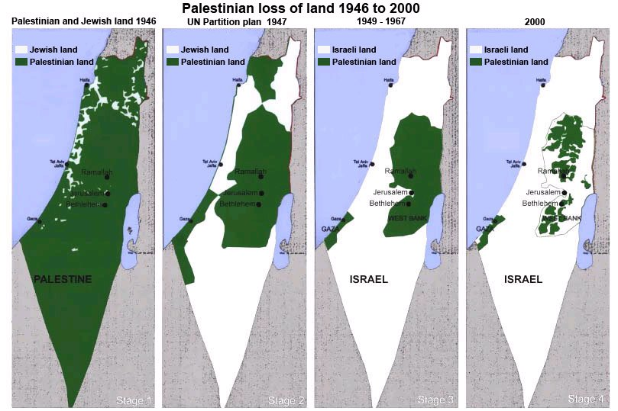
History

Slide 3
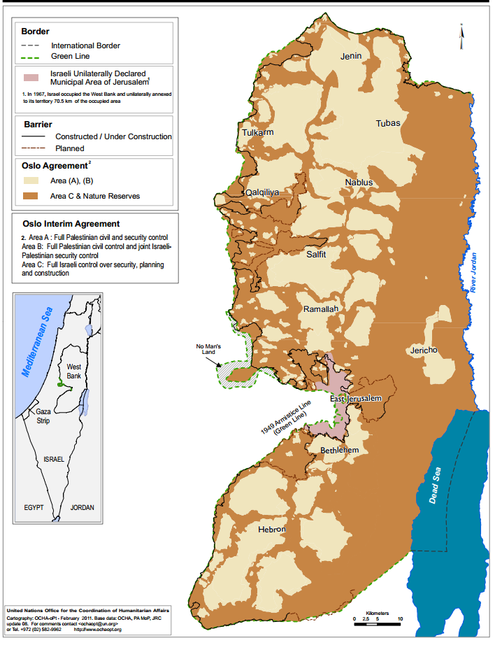
Oslo agreement

Slide 4
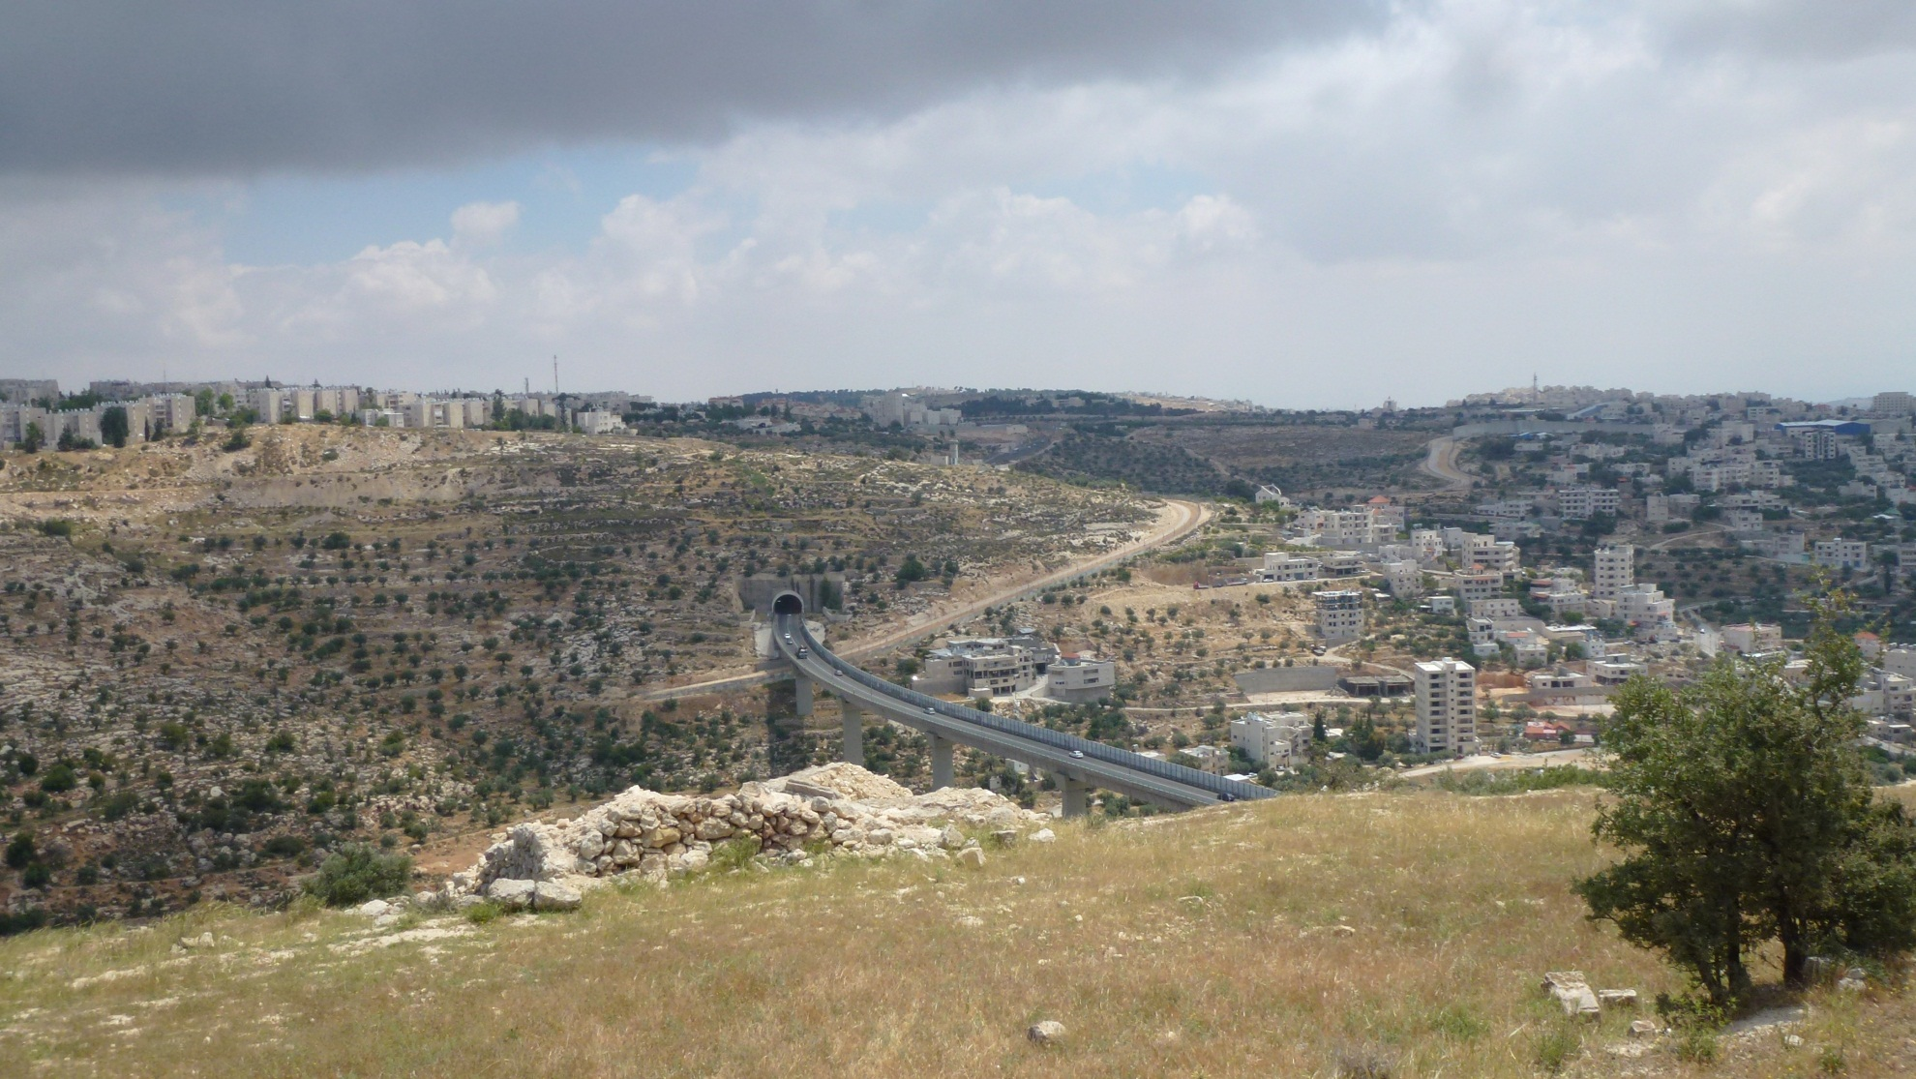
Area A B C

Slide 5
A continuing suffering
Land annexation
Military presence
Discrimination

Slide 6
Land annexation
Settlements
Seperation Barrier
Demolitions

Slide 7
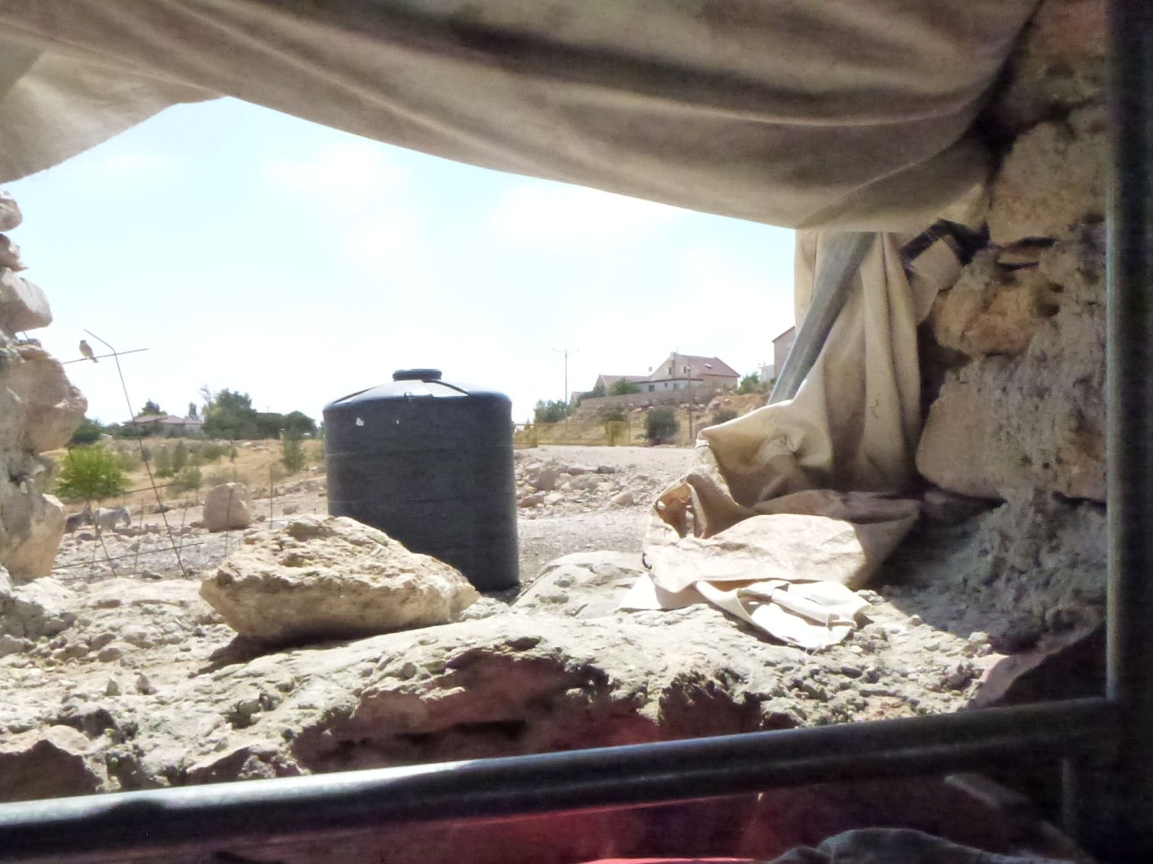
Settlements
Fourth Geneva Conventions Article 49
„The Occupying power shall not deport
Or transfer part of ist own civilian population
Into the territories it occupies“
Notes:
"The Occupying Power shall not deport or transfer parts of its own civilian population into the territory it occupies."

Slide 8
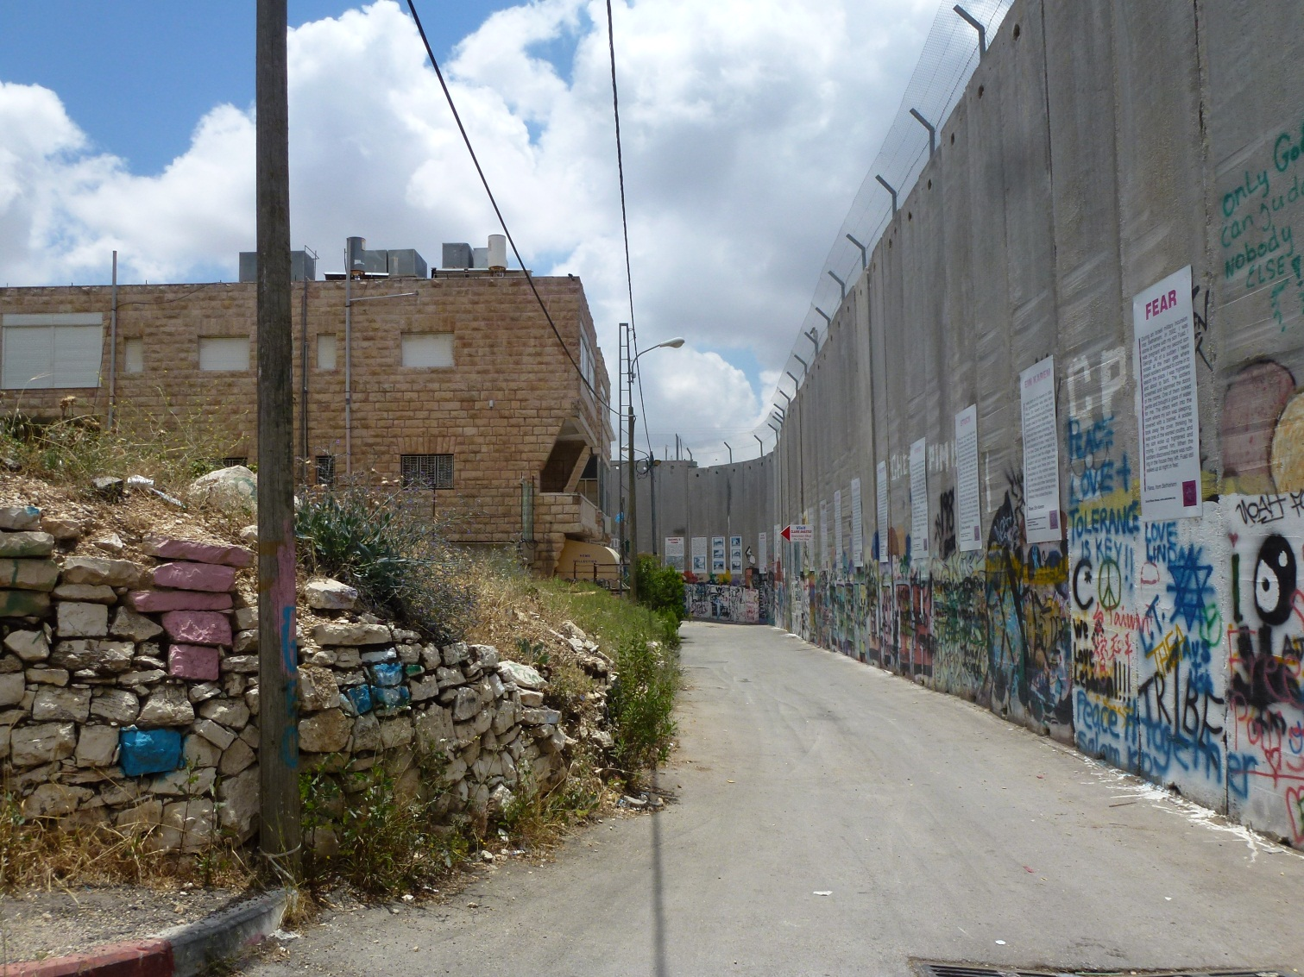
Separation Barrier

Slide 9
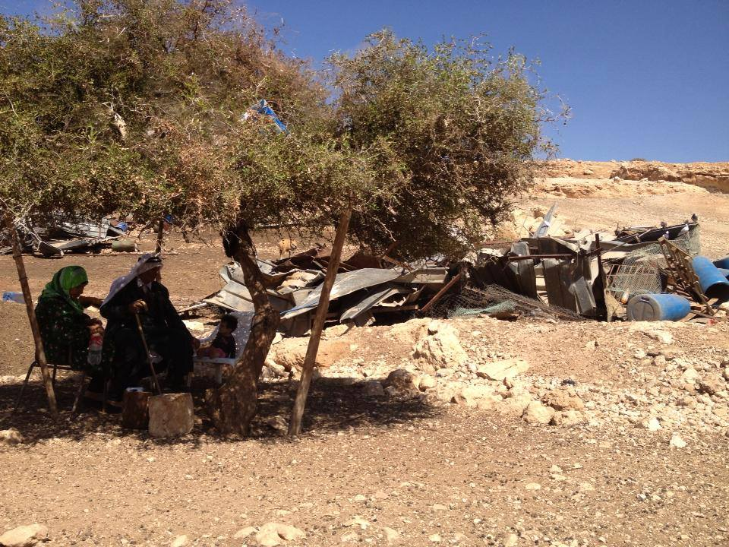
Demolitions

Slide 10
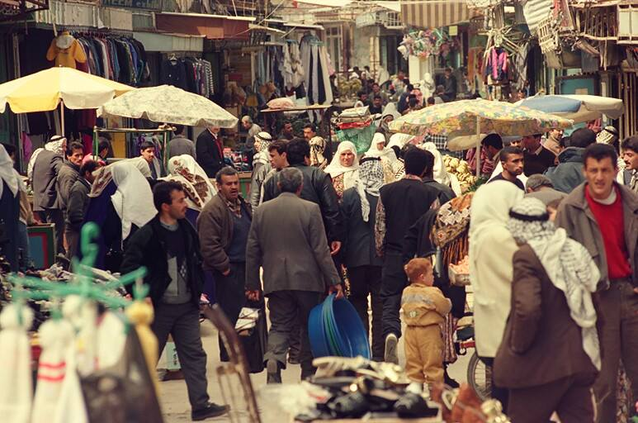
Closures

Slide 11
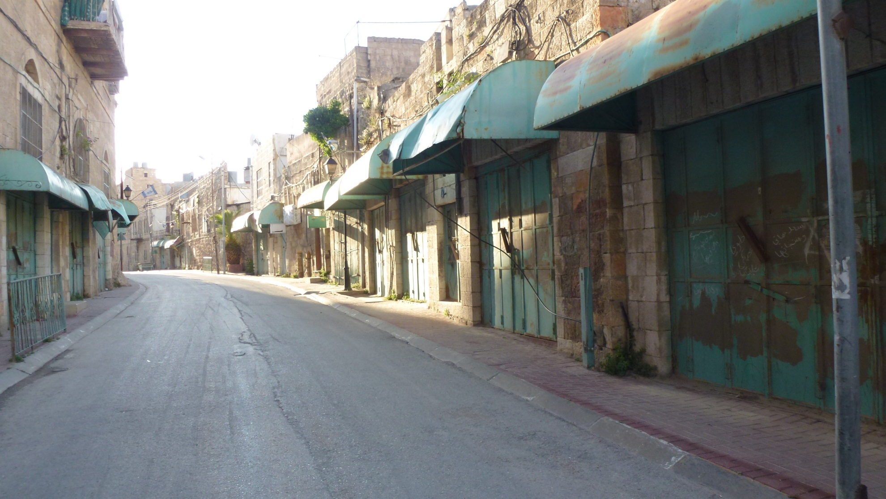
Closures

Slide 12
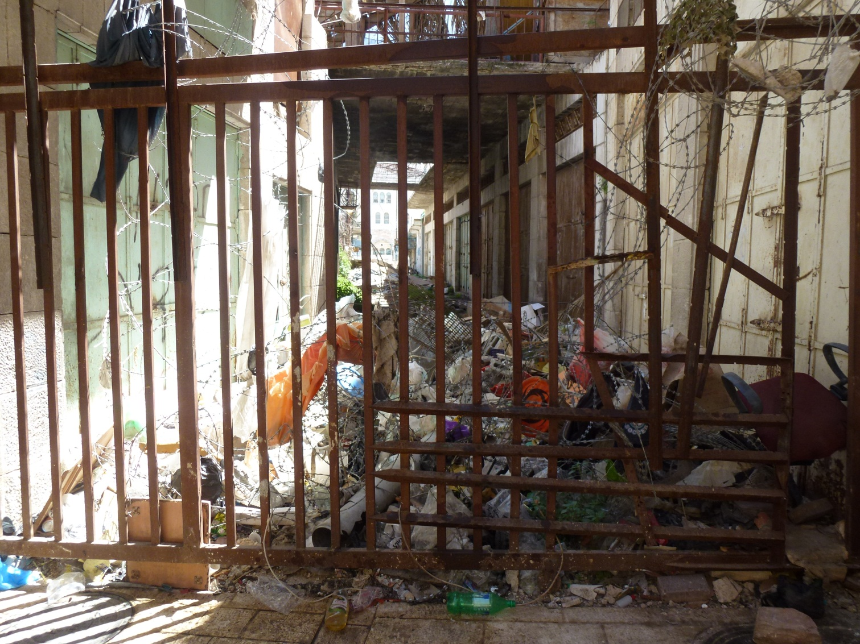
Settler violence

Slide 13
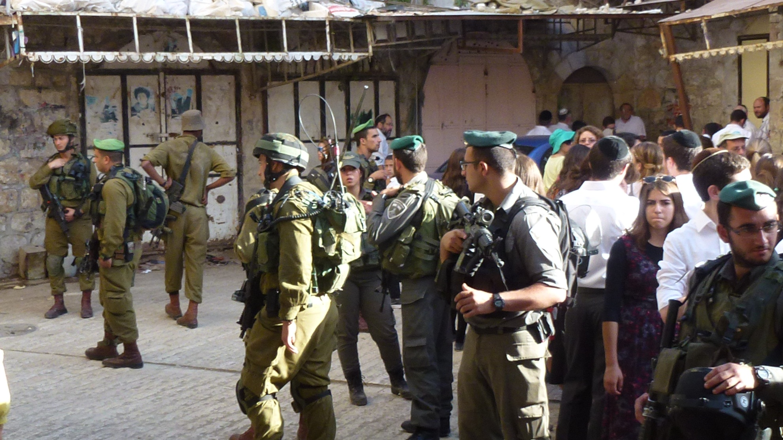

Slide 14
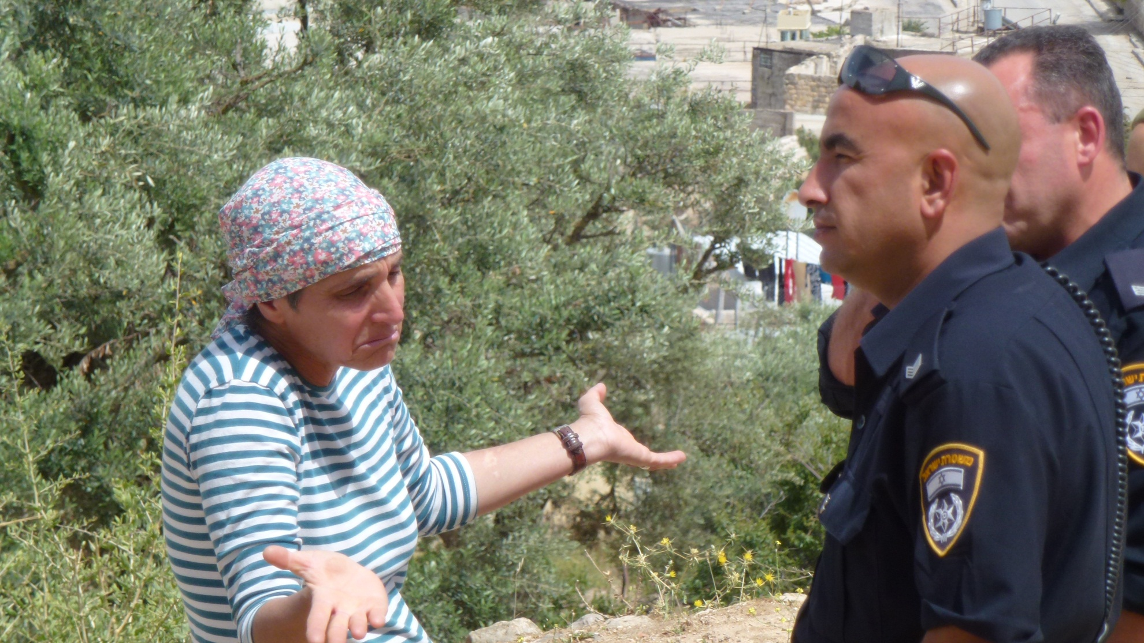
Settler violence

Slide 15
Military presence
Checkpoints
Arbitrary arrests
Violence and impunity

Slide 16
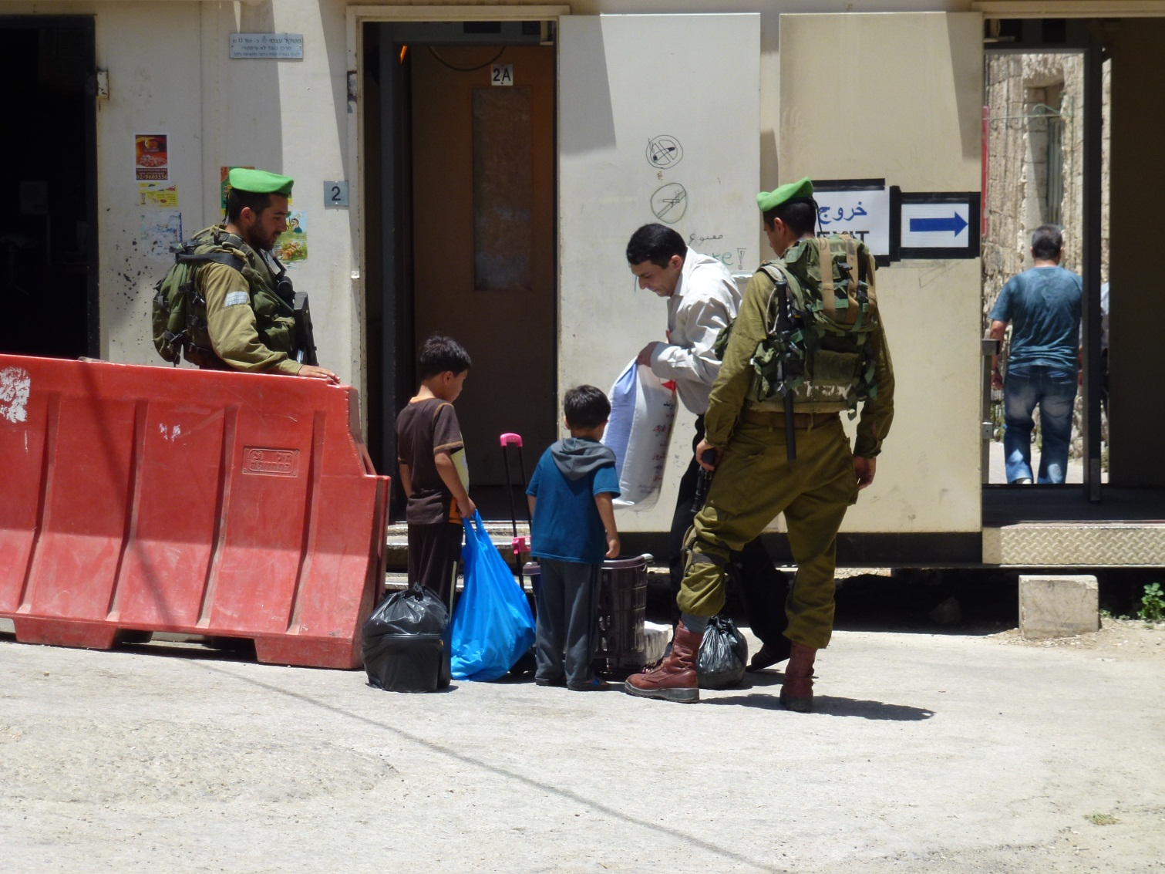
Checkpoints

Slide 17
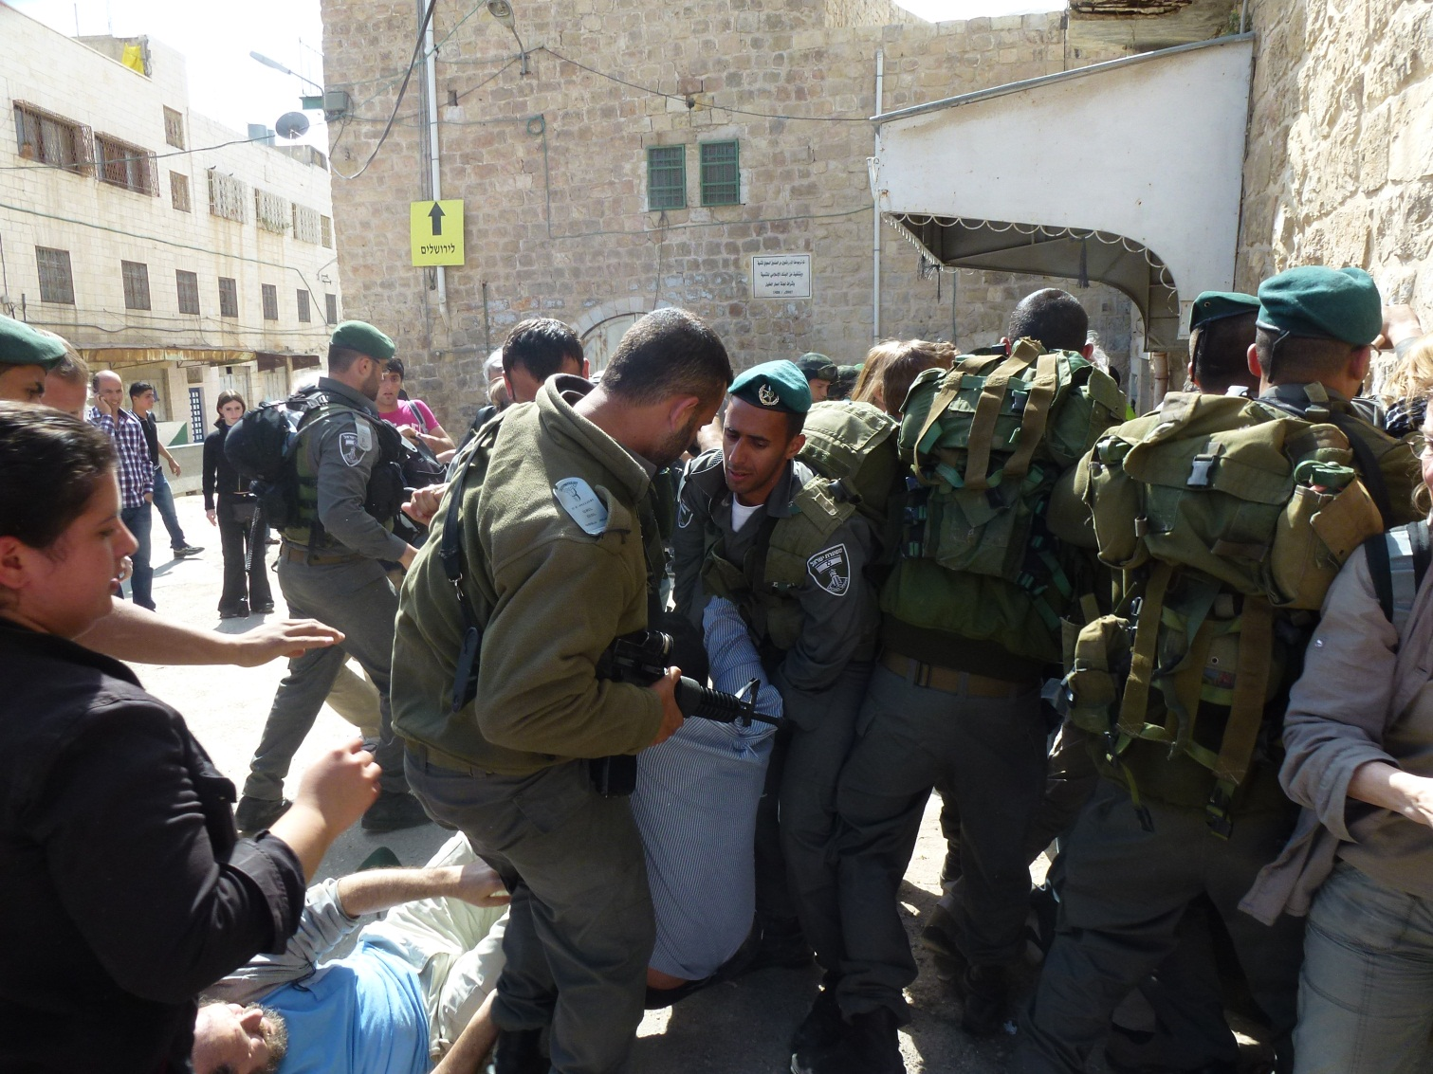
Arbitrary arrests

Slide 18
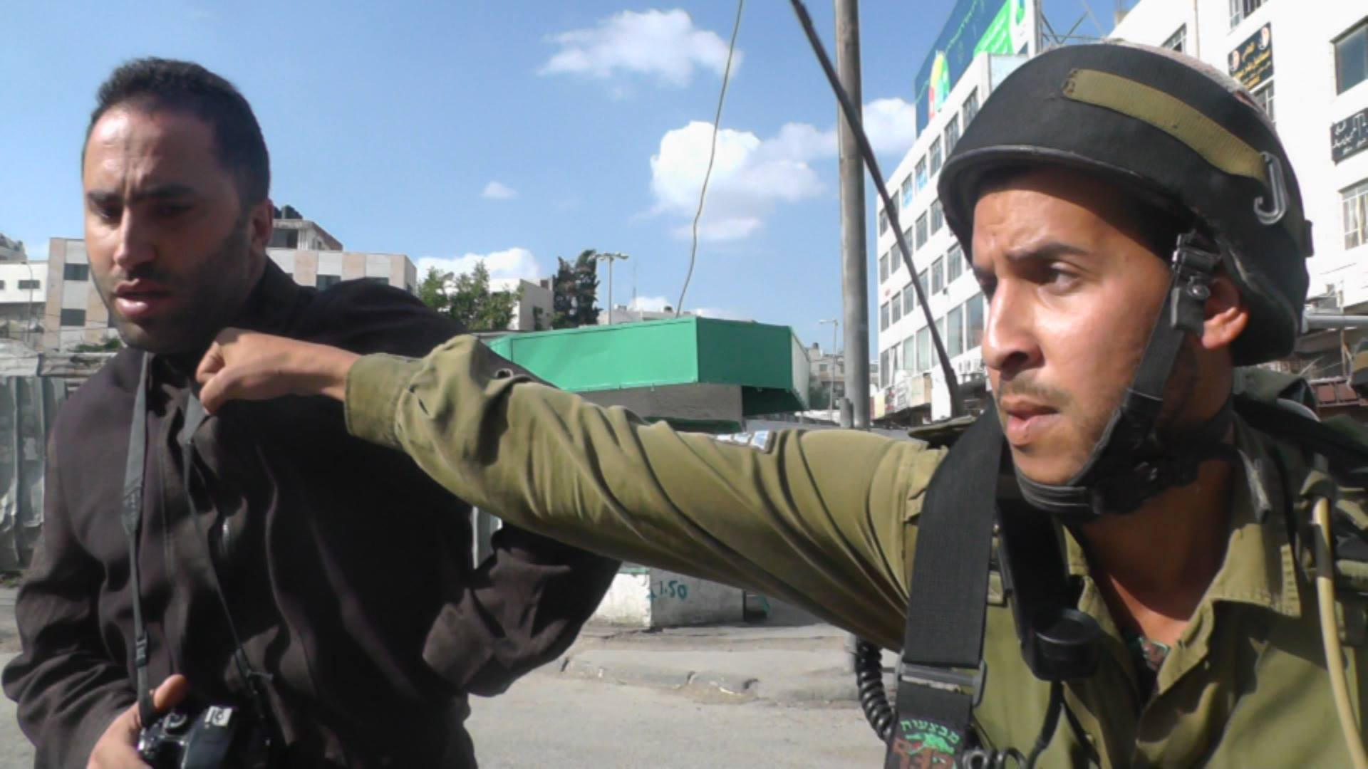
Violence

Slide 19
Violence
https://www.youtube.com/watch?v=CaibEqx2m_k

Slide 20
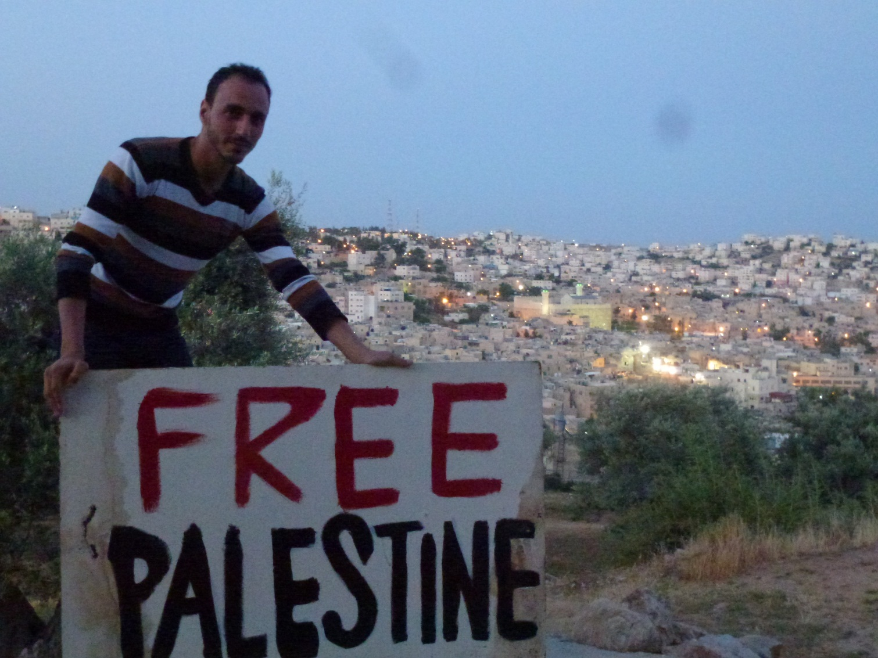
Lack of identity

