Slide 1
Women in conflict
Tuesday 25/03/2014

Slide 2

Women in conflict
When war erupts, women are often the first to experience the harsh brutality and the last to be called to the peace table.
Phumzile Mlambo-Ngcuka, UN Women Executive Director

Slide 3
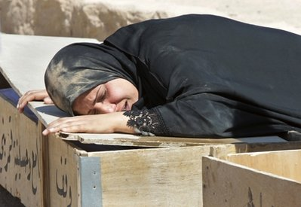
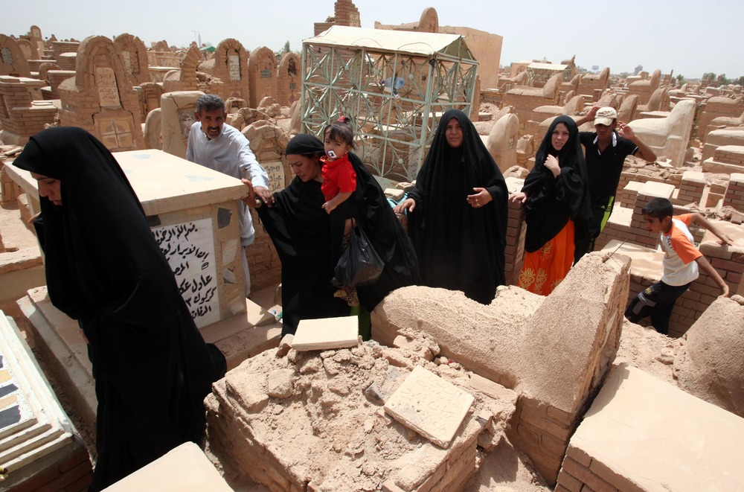
Widows

Slide 4
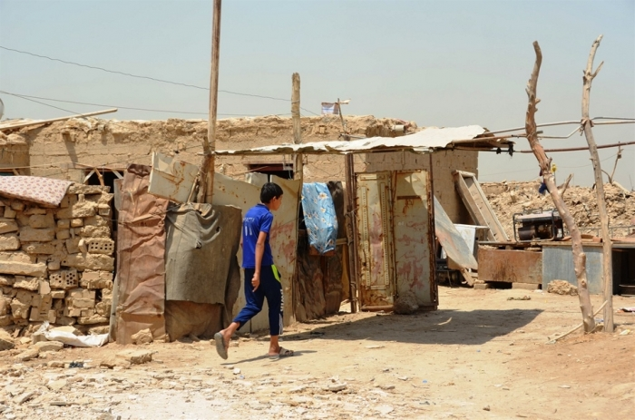
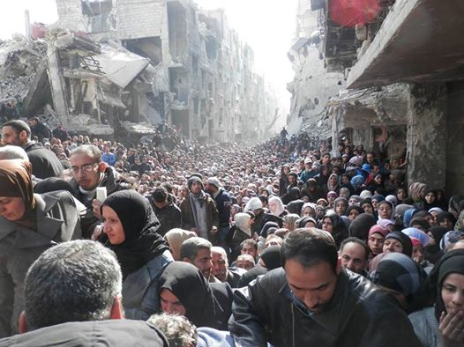
Displacement
An informal settlement for displaced people on the outskirts of Baghdad
Yarmouk: Refugees waiting for food deliveries at a UNRWA humanitarian distribution point.

Slide 5
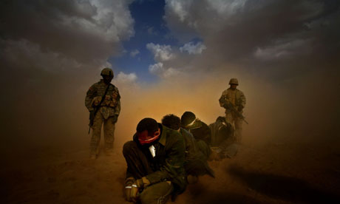
Disappeared
According to one British serviceman who was at Nama, US soldiers would bring prisoners in every night.

Slide 6
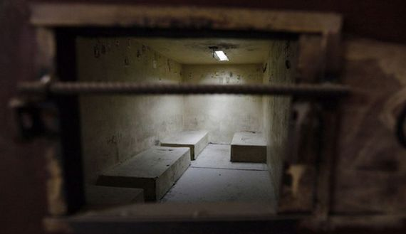
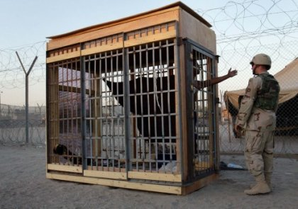
Detention
An empty cell in an Iraqi prison.
Abu Ghraib

Slide 7
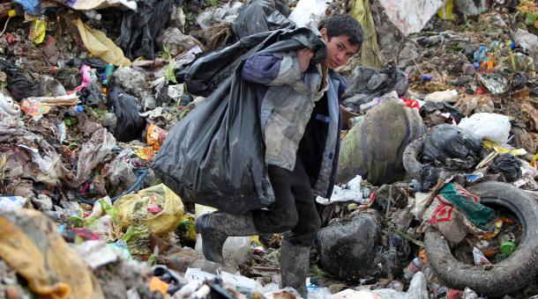
Poverty
An Iraqi boy searches for plastic bottles in a garbage dump on the outskirts of Baghdad's impoverished district of Sadr City, January 30, 2013. Around a quarter of Iraq's population are estimated by the country's Planning Ministry to live in poverty.

Slide 8
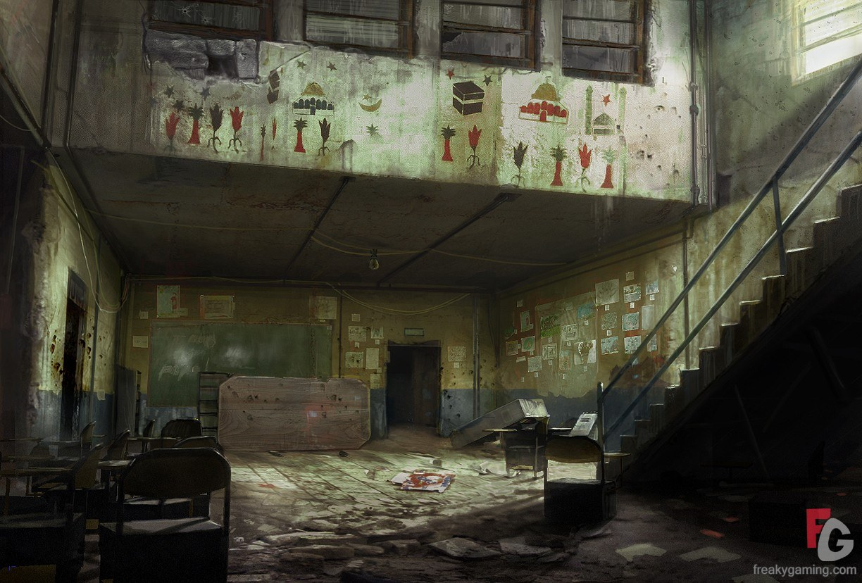
Education
A Dirty Iraqi School, With Desks Tipped Over And Papers Spread Out

Slide 9
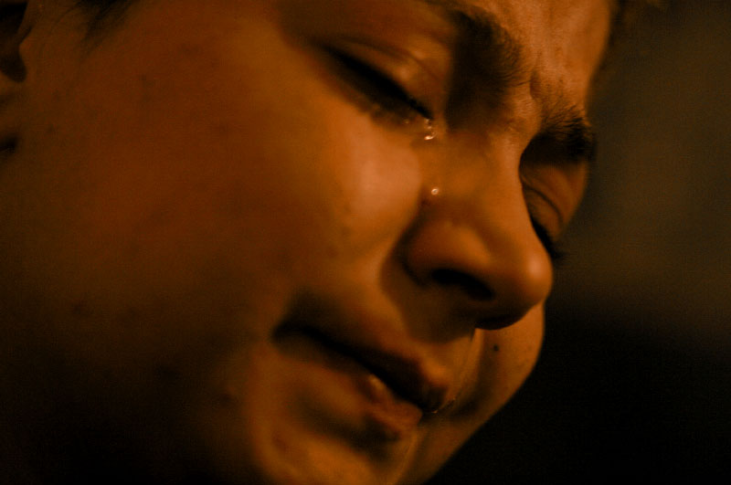
Sexual Exploitation

Slide 10
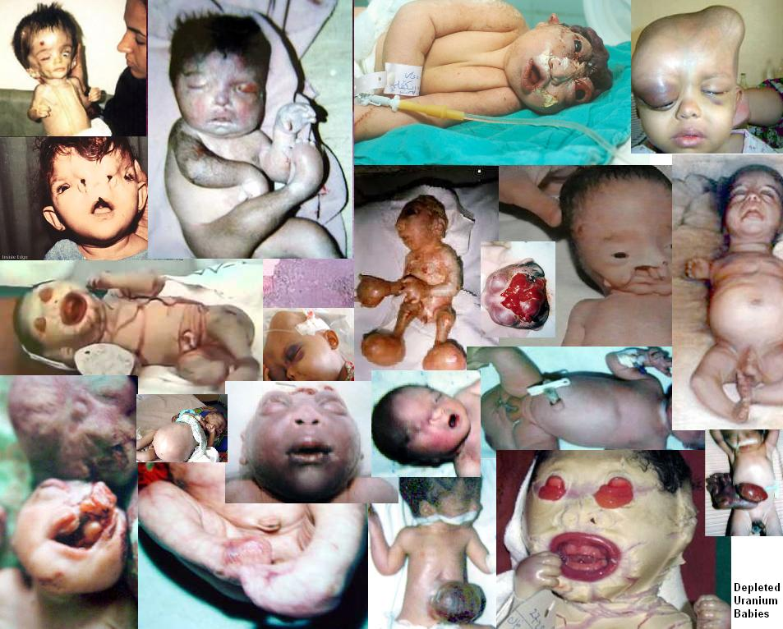
health

